Slide 1
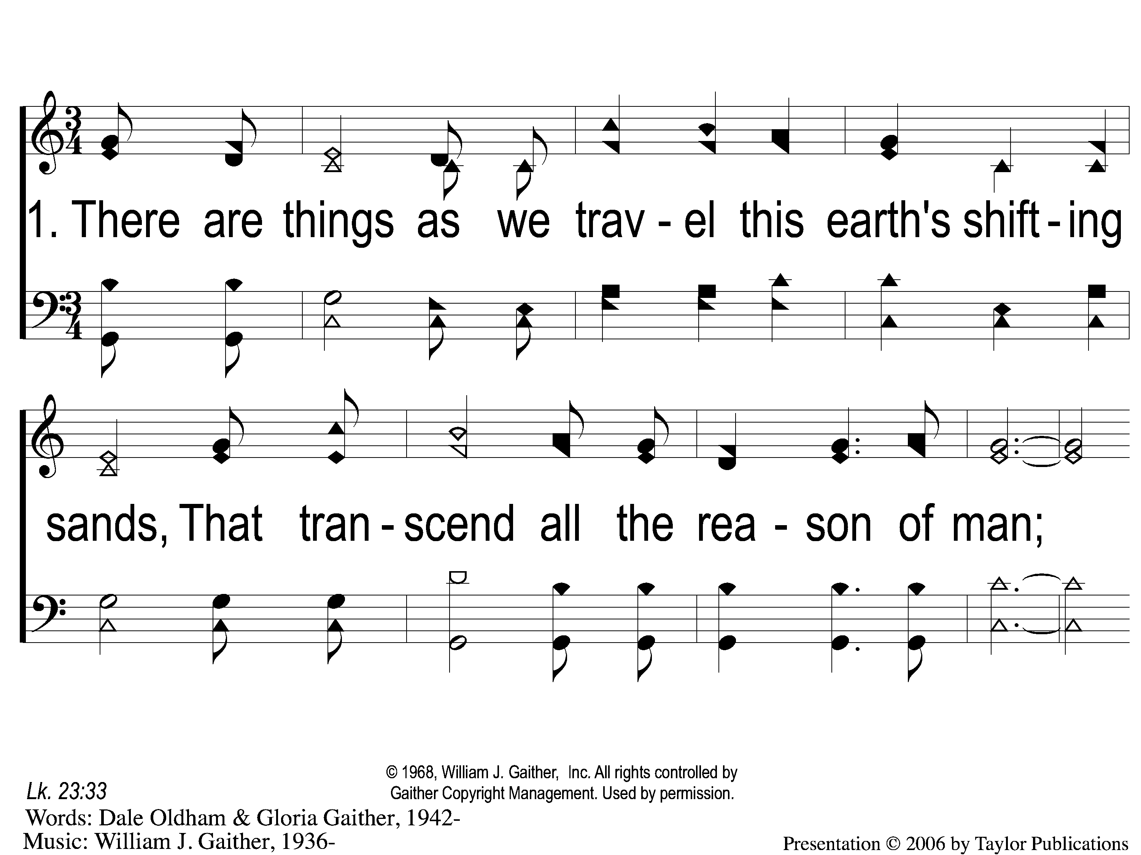
1-1 A Hill Called Mount Calvary
A Hill Called Mount Calvary
595b

Slide 2
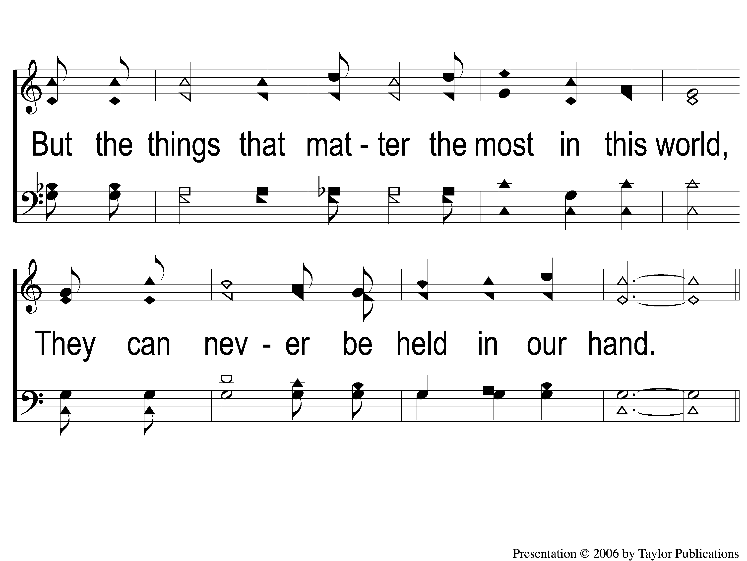
1-2 A Hill Called Mount Calvary
A Hill Called Mount Calvary
595b

Slide 3
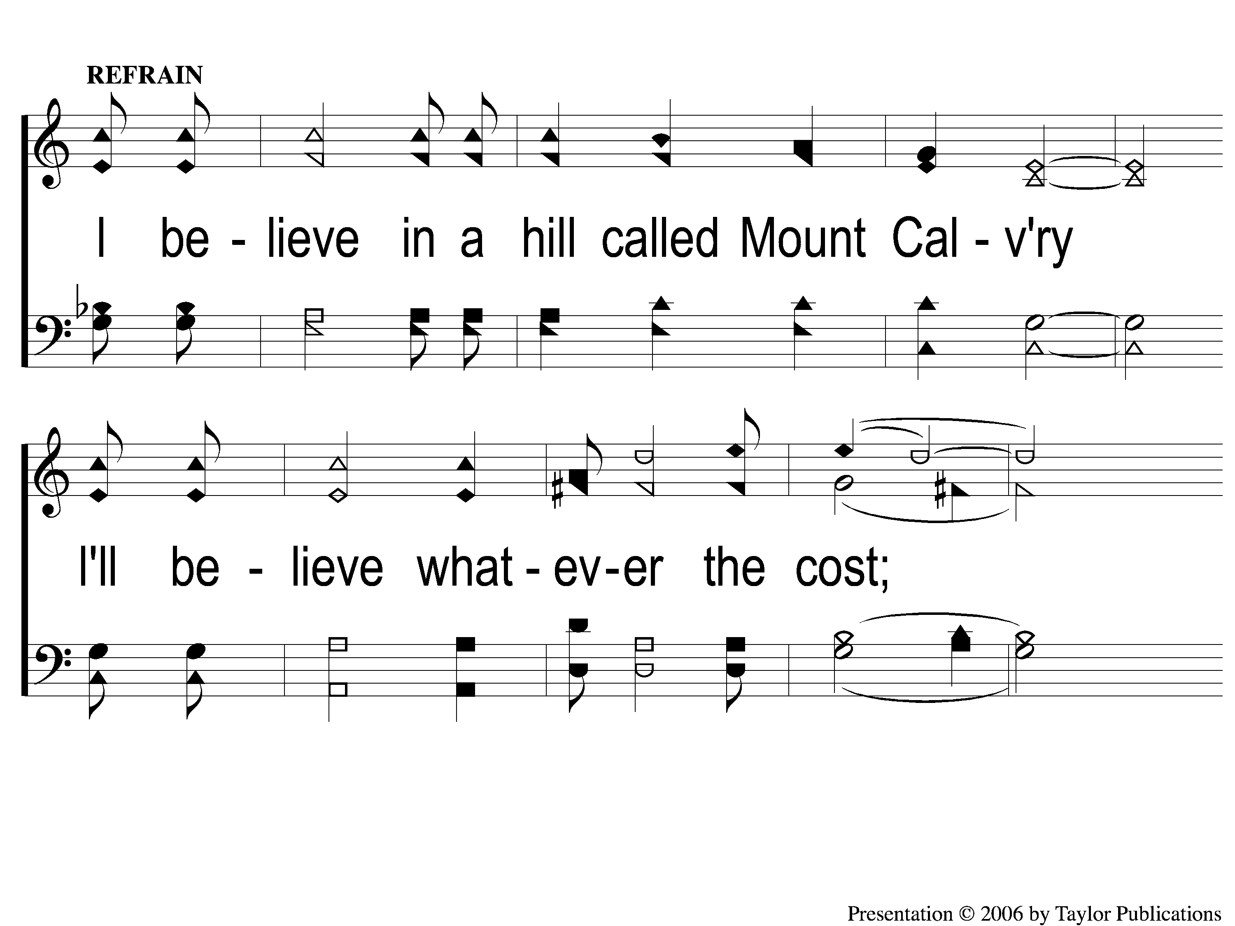
C-1 A Hill Called Mount Calvary
A Hill Called Mount Calvary
595b

Slide 4
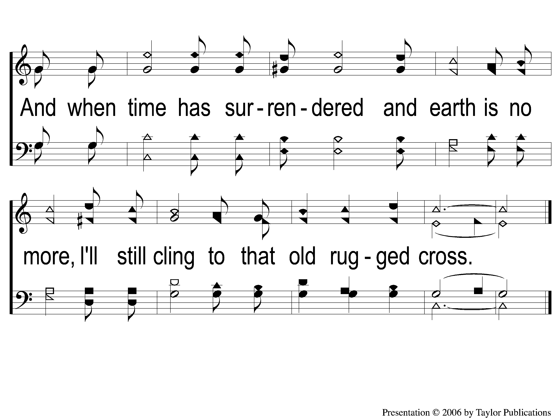
C-2 A Hill Called Mount Calvary
A Hill Called Mount Calvary
595b

Slide 5
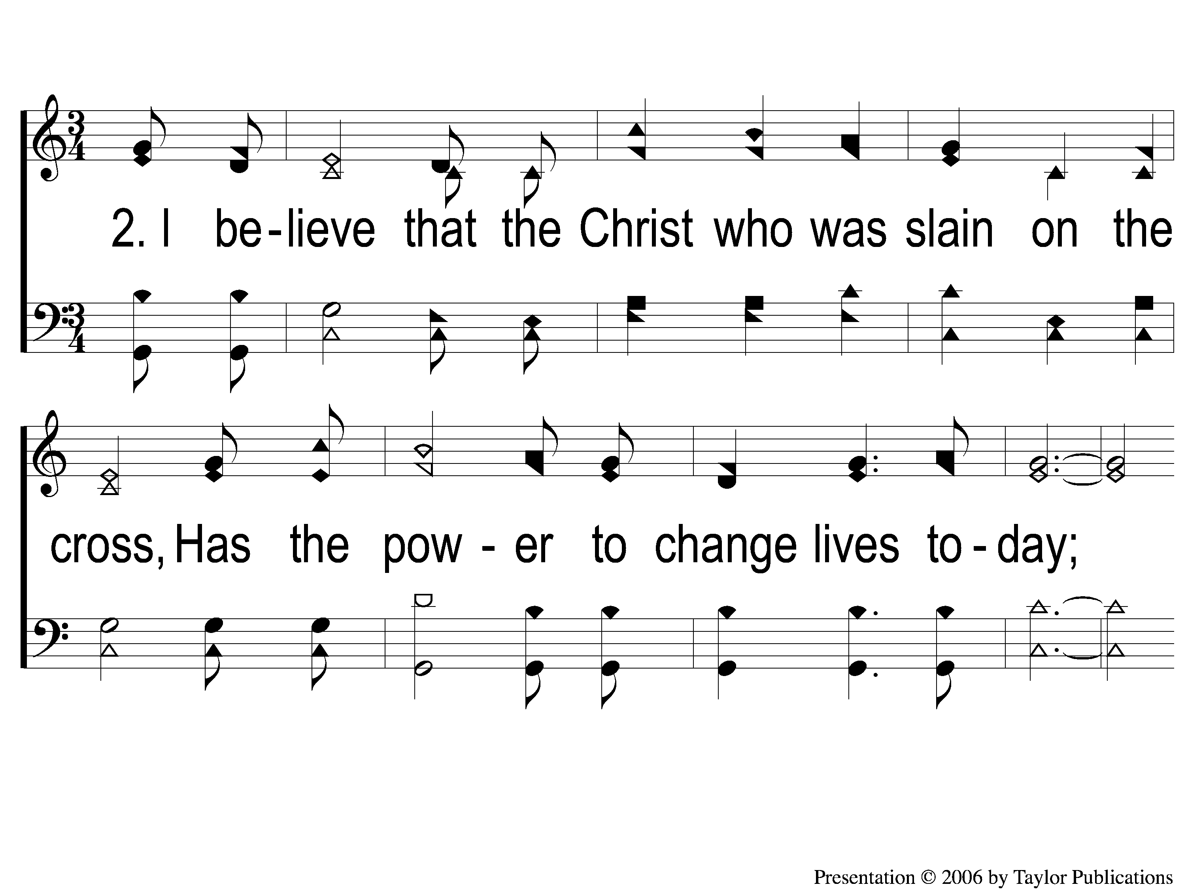
2-1 A Hill Called Mount Calvary
A Hill Called Mount Calvary
595b

Slide 6
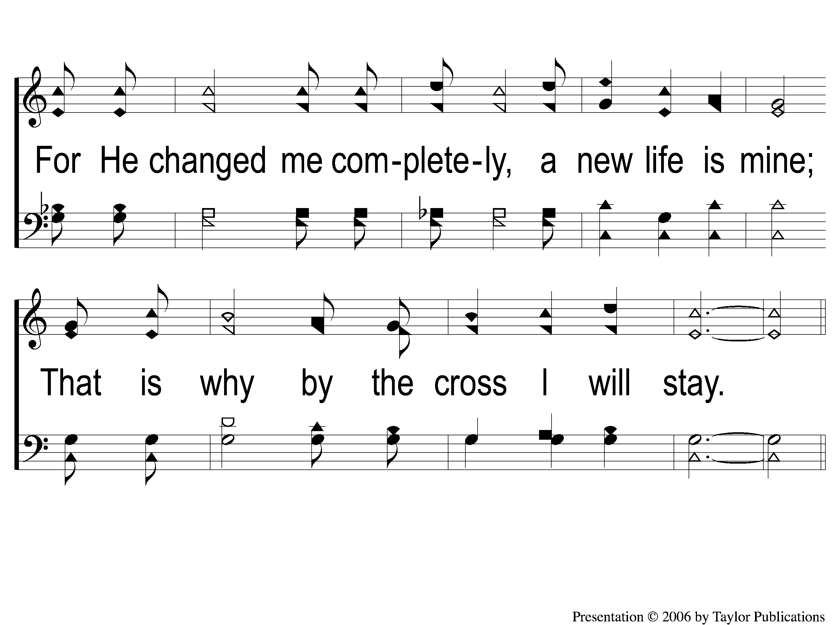
2-2 A Hill Called Mount Calvary
A Hill Called Mount Calvary
595b

Slide 7
C-1 A Hill Called Mount Calvary
A Hill Called Mount Calvary
595b

Slide 8
C-2 A Hill Called Mount Calvary
A Hill Called Mount Calvary
595b

Slide 9
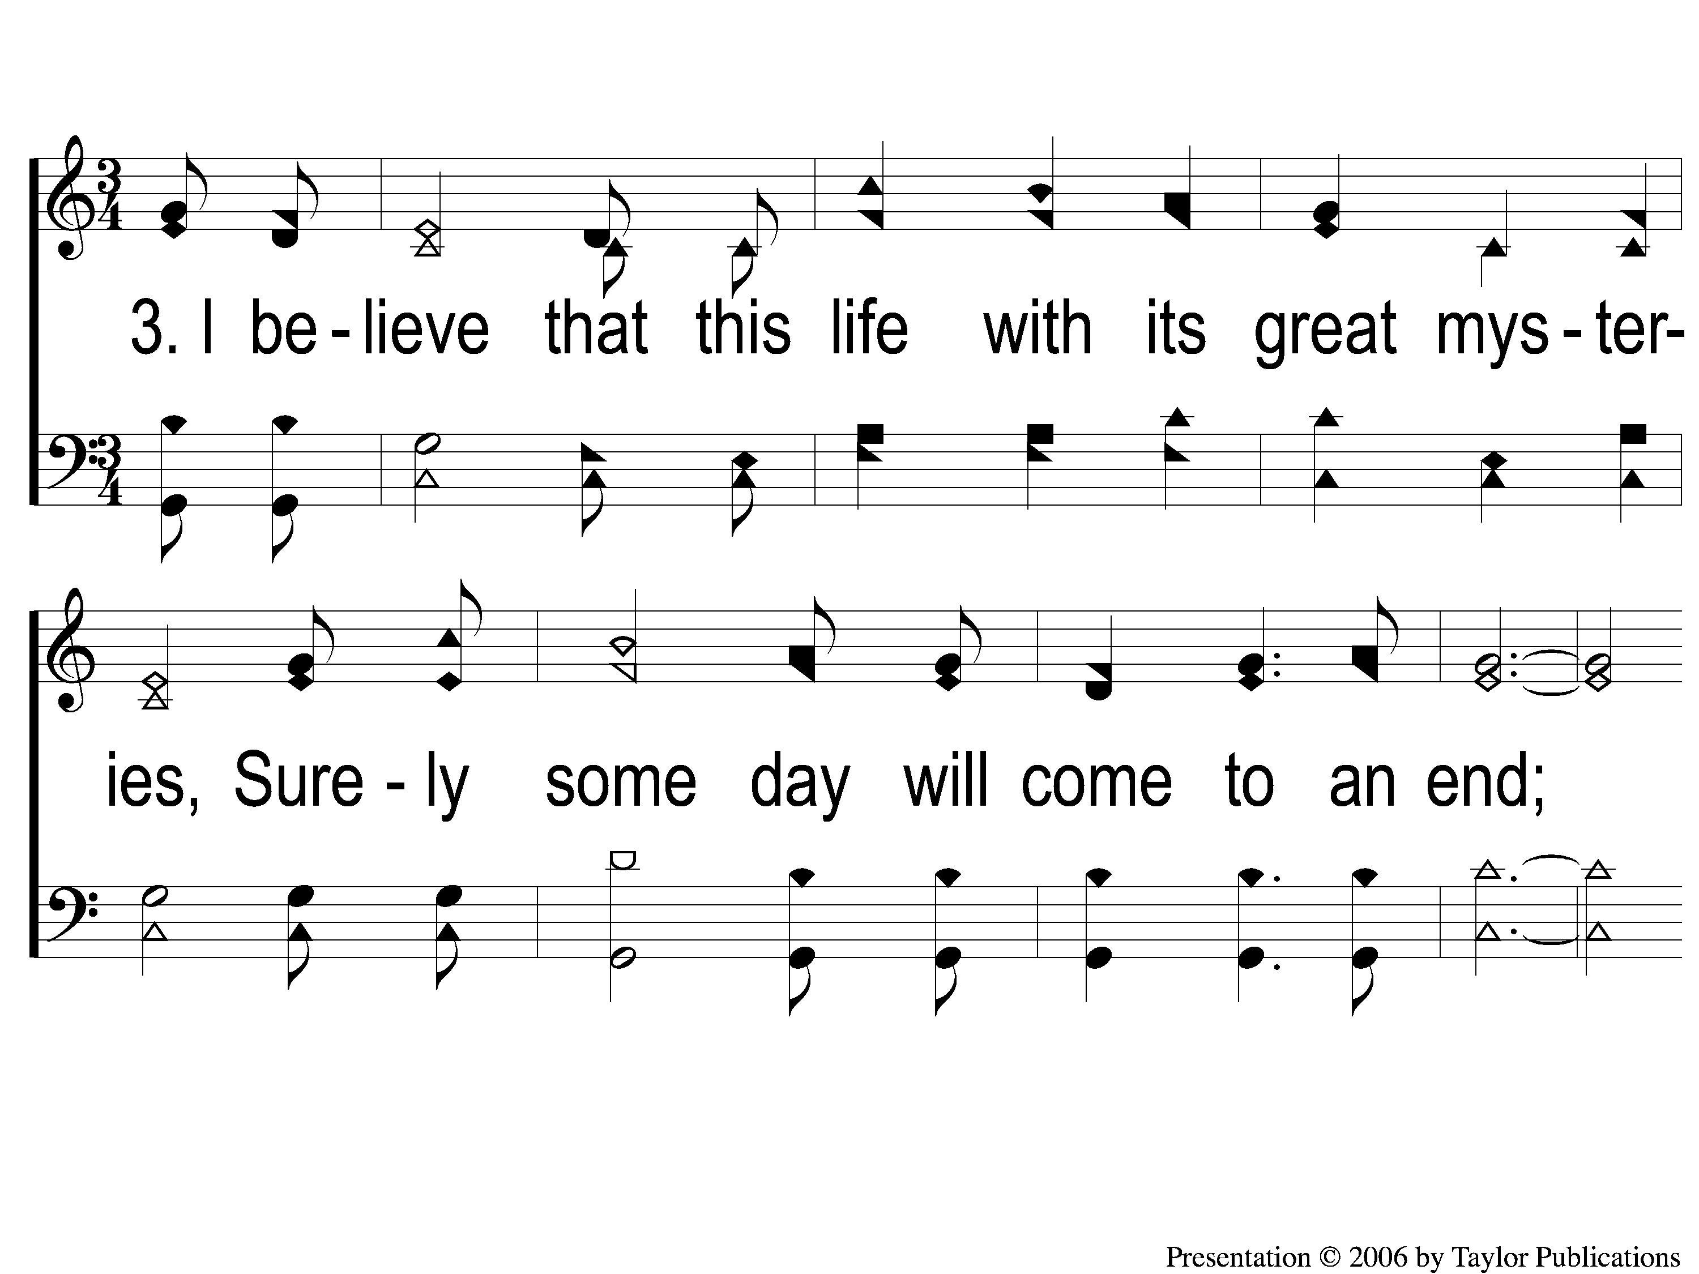
3-1 A Hill Called Mount Calvary
A Hill Called Mount Calvary
595b

Slide 10
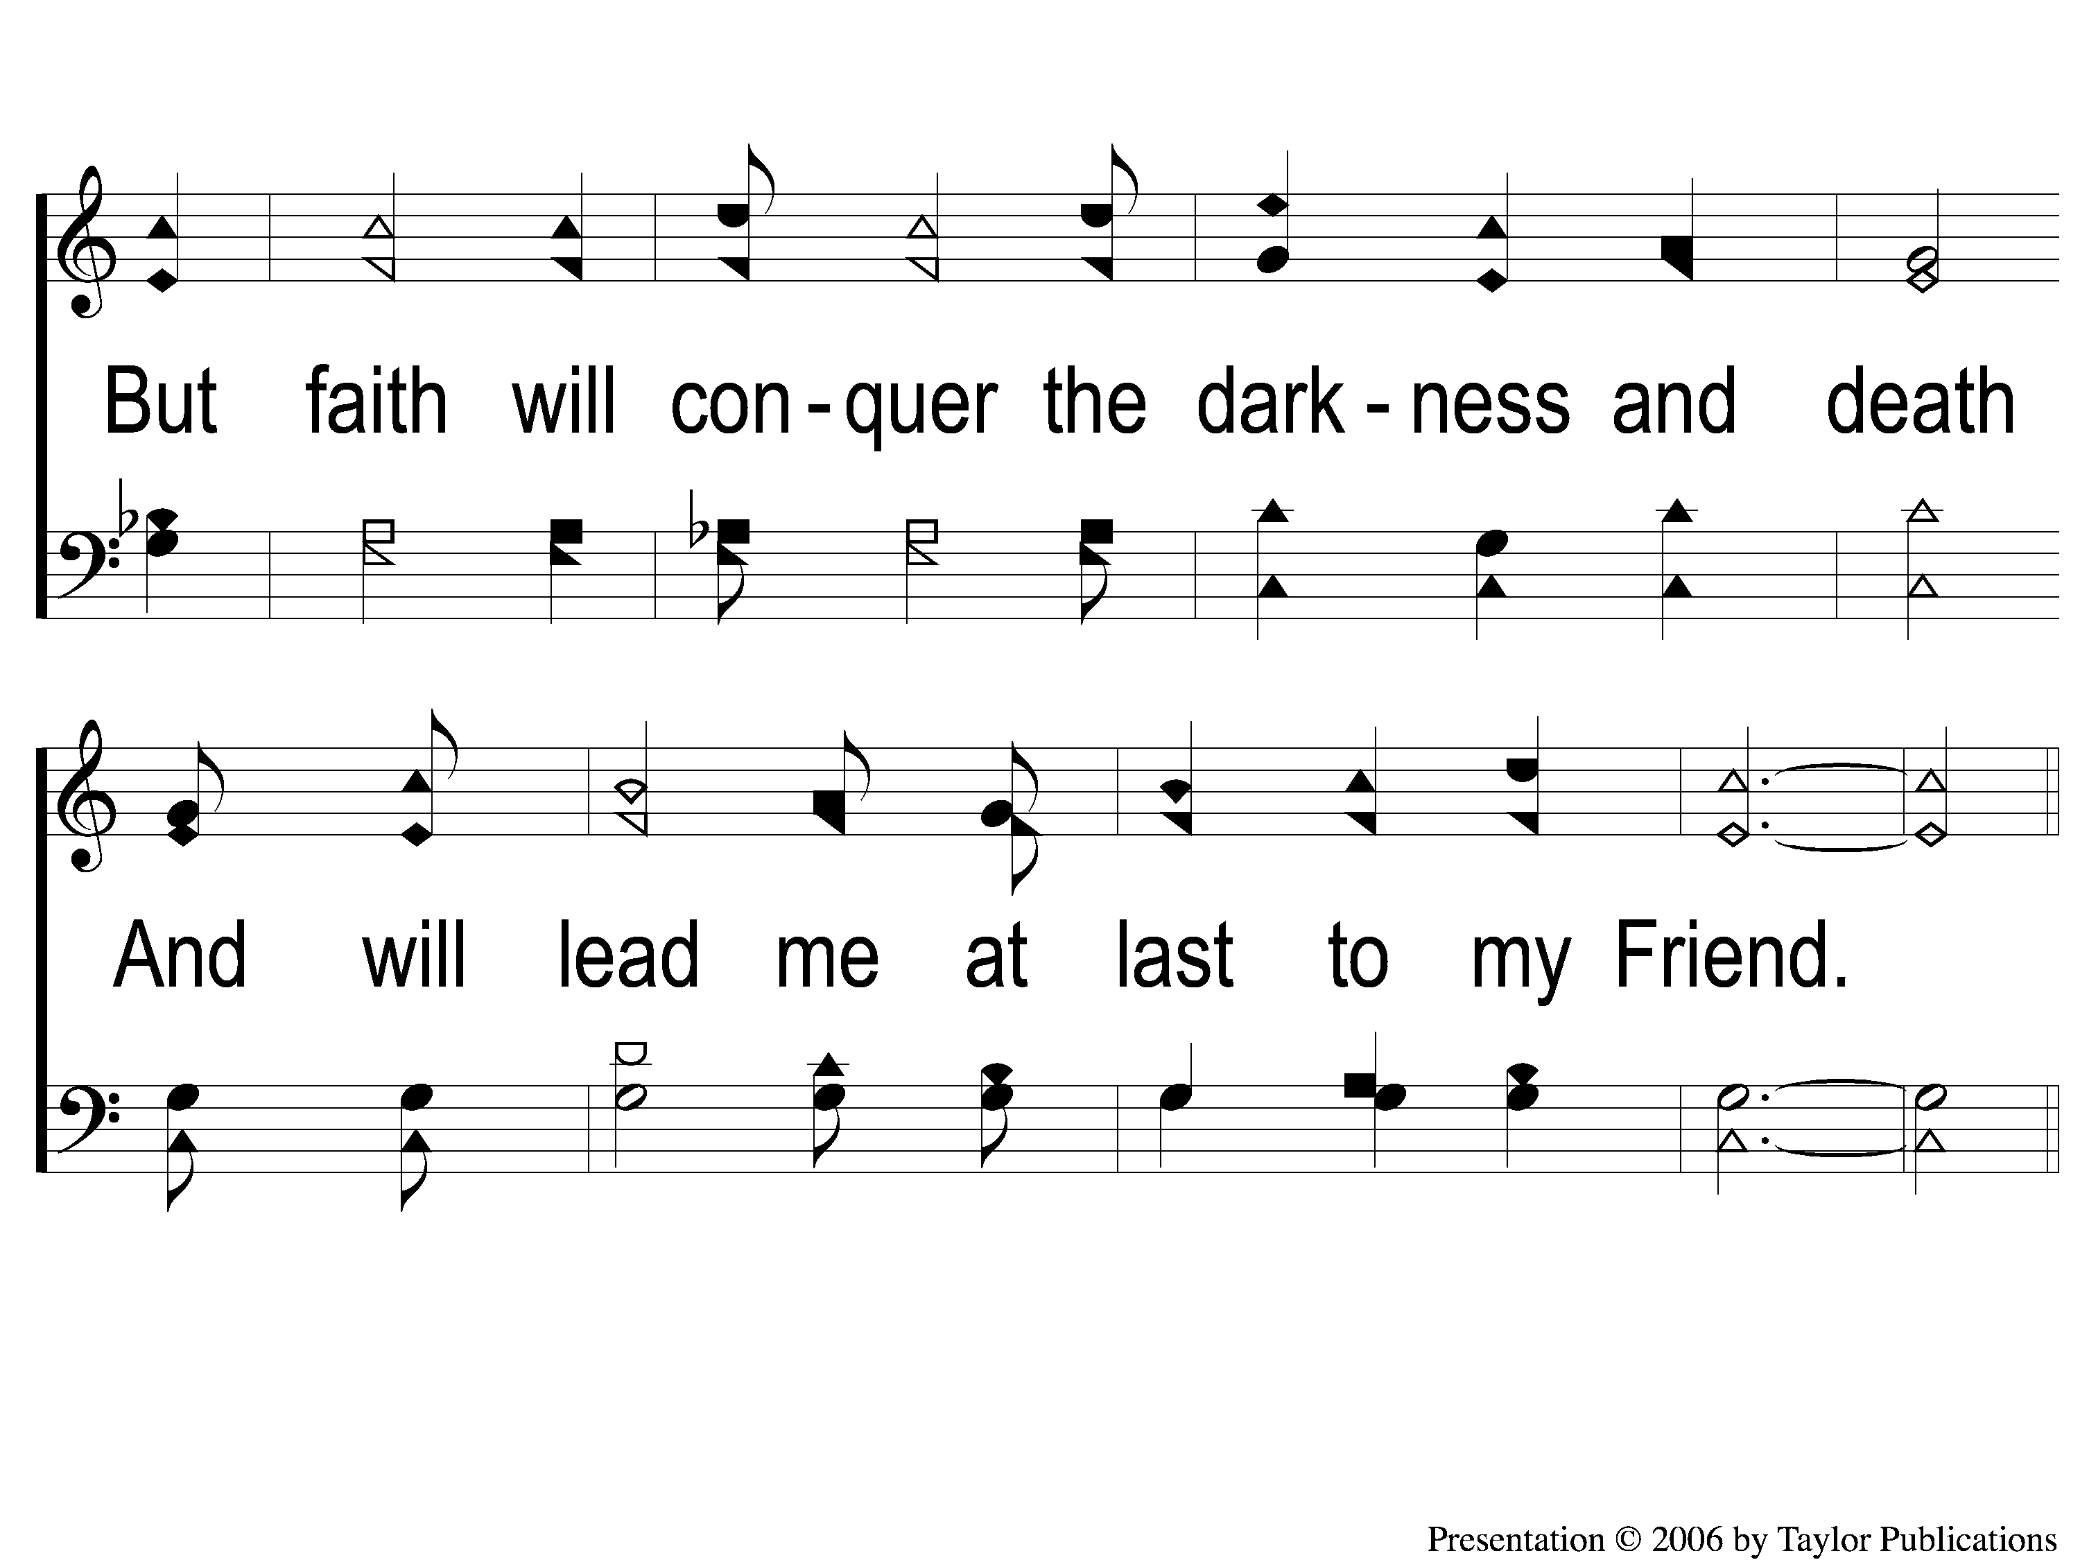
3-2 A Hill Called Mount Calvary
A Hill Called Mount Calvary
595b

Slide 11
C-1 A Hill Called Mount Calvary
A Hill Called Mount Calvary
595b

Slide 12
C-2 A Hill Called Mount Calvary
A Hill Called Mount Calvary
595b

